Slide 1
Maze generation

Slide 2
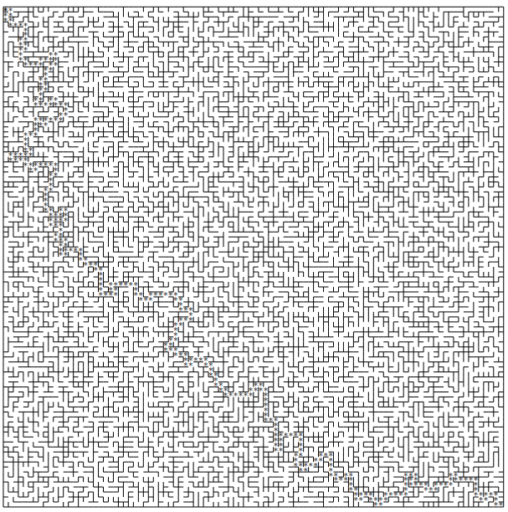
Can I generate a maze with a path from start to goal?

Slide 3
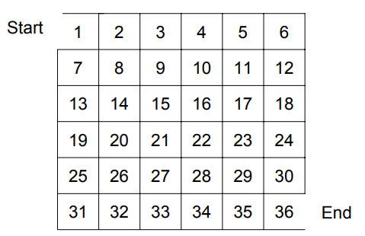
Generate a Random Maze
Assuming we have some n x n maze that every single “cell” is isolated
E.g. this is a 6 x 6 maze
cell

Slide 4
Generate a Random Maze
And we can randomly “break a wall” between two cells
e.g. breaking this wall

Slide 5
Generate a Random Maze
After breaking a wall, two cells are connected
e.g. now cells 11 and 17 are connected

Slide 6
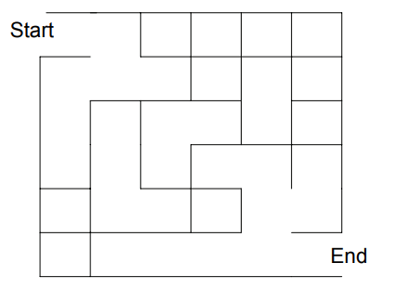
Generate a Random Maze
We can break some walls randomly
However, after breaking some walls, the maze may not be “solvable”

Slide 7
Generate a Random Maze
Algorithm:
Repeat
Break some walls randomly
Until the maze is solvable
If the maze is large, say n x n, how fast is this step?
BSF : O(V+E) = O(n²)

Slide 8
Generate a Random Maze
Let’s generate n x n sets of the cells
{1}, {2}, … , {35}, {36}
After breaking a wall, two cells are connected
e.g. now cells 11 and 17 are connected
We union sets 11 and 17!
So the collection will be
{1}, {2}, … , {11,17}, …{35}, {36}

Slide 9
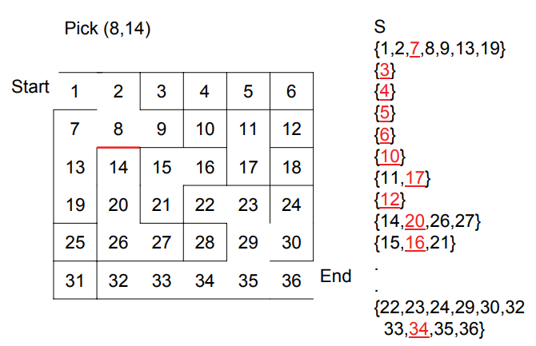
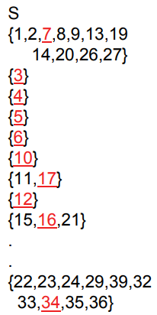
Generate a Random Maze
Whenever I break a wall, I union the two neighboring cells, e.g. breaking (8,14)
U

Slide 10
Generate a Random Maze
Whenever I break a wall, I union the two neighboring cells,
e.g. breaking (8,14)
U

Slide 11
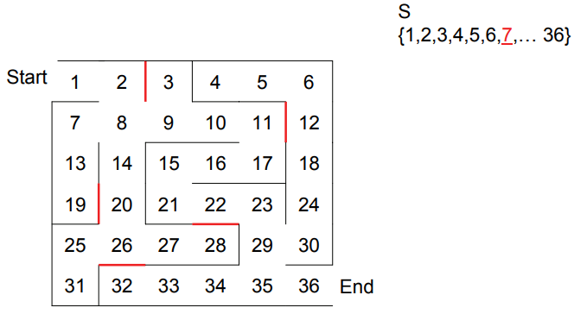
Generate a Random Maze
One simple way is you can break it until
Cell 1 and Cell 36 are in the same set, or
All cells belongs to one single set

Slide 12
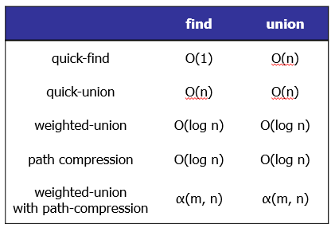
Generate a Random Maze
Algorithm:
Repeat
Break some walls randomly
Until the maze is solvable
If the maze is large, say n x n, how fast is this step?
BSF : O(V+E) = O(n²)
Very close to O(1) !

Slide 13
Union-find Data Structure
ADT
A set of disjoints sets
fromWhichSet(s) O(α(n,n))
Union(a, b) O(α(n,n))
isSameSet(s1, s2) O(α(n,n))

Slide 14
Facebook
How do you tell if two persons are “connected”?
A friend of friends of friends….
And people are becoming friends of each other “dynamically”
Alan knows Billy, Billy knows Cindy
Danny knows Emily, Emily knows Frank
And Alan and Danny are not “connected”
One day, Cindy knows Frank…

Slide 15
About Connectivity
Network:
Are two servers connected?
Map
Can I take a public transport from one point to another point?

Slide 16
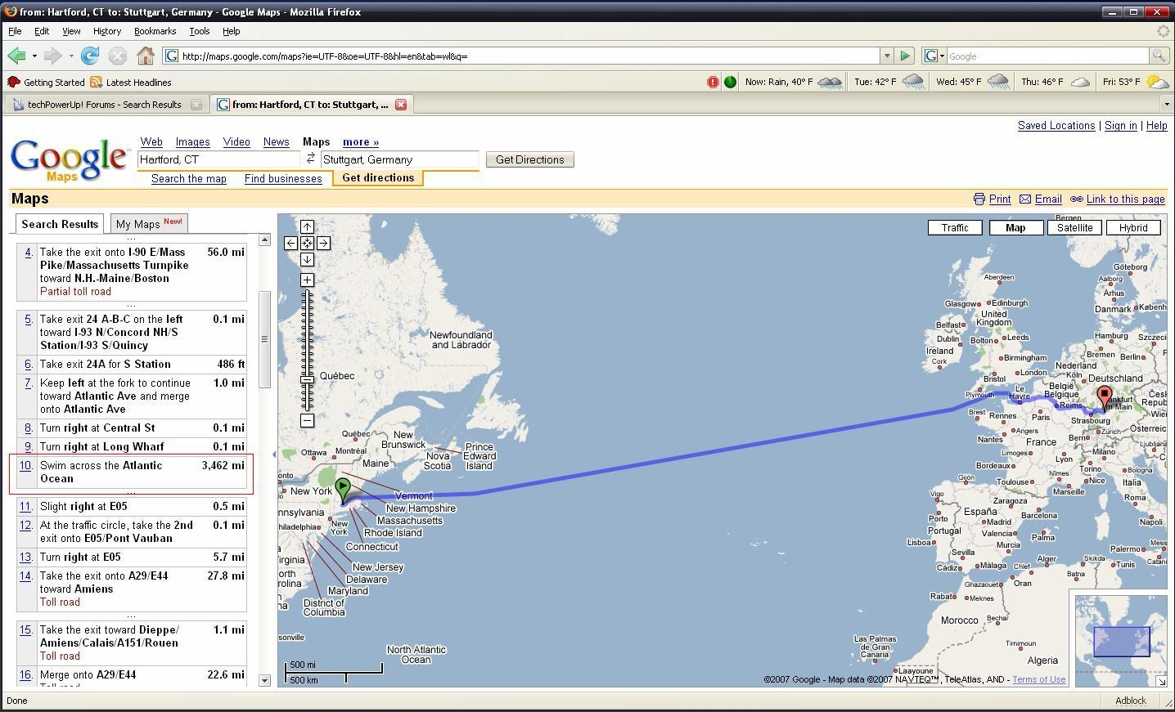
How to “Walk” from Paris to New York?
Google Maps Tells its users to 'Swim across the Atlantic Ocean'

Slide 17
Visualgo: If we have 3 sets
A = {0,1,2,3,4}
B = {5, 6, 7}
C = {8}
We want to ask
If 3 and 5 are in the same set?
Ans: no
What if we merge the two sets A and B together to become A union B?

Slide 18
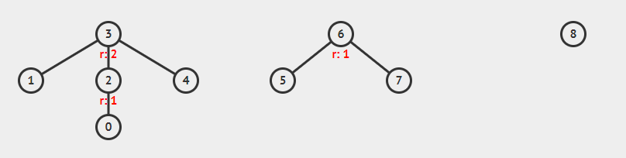
Union-find Data Structure
Choose “Union-find Disjoint Sets” in Visualgo
Select “Examples” > “Three Disjoint Sets”

Slide 19
Query isSameSet()
Query, is 6 and 7 in the same set?
Find the root of 6
6
Find the root of 7
6
Because the roots are the same
6 and 7 are in the same set

Slide 20
Query isSameSet()
Query, is 3 and 5 in the same set?
Find the root of 3
3
Find the root of 5
6
Because 3 is not equal to 6
3 and 5 are NOT in the same set

Slide 21
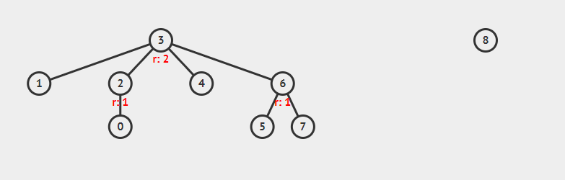
Union
Let’s merge the set of 3 and 5 together
Perform UnionSet(3,5)
The two sets become one

Slide 22
Query isSameSet()
Query, is 3 and 5 in the same set?
Find the root of 3
3
Find the root of 5
3
Because the roots are the same
3 and 5 are in the same set NOW!

Slide 23
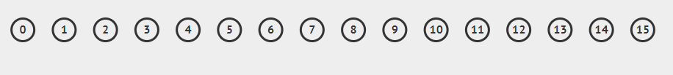
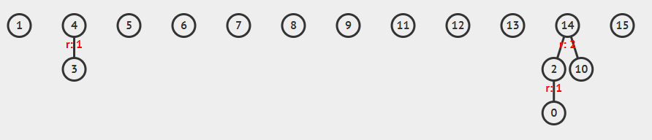
Union
Try initialize 16 different sets
And union some of them,
e.g. 0 and 2, 3 and 4, 10 and 14, 0 and 10

